Slide 1
Dynamic Vision

Slide 2
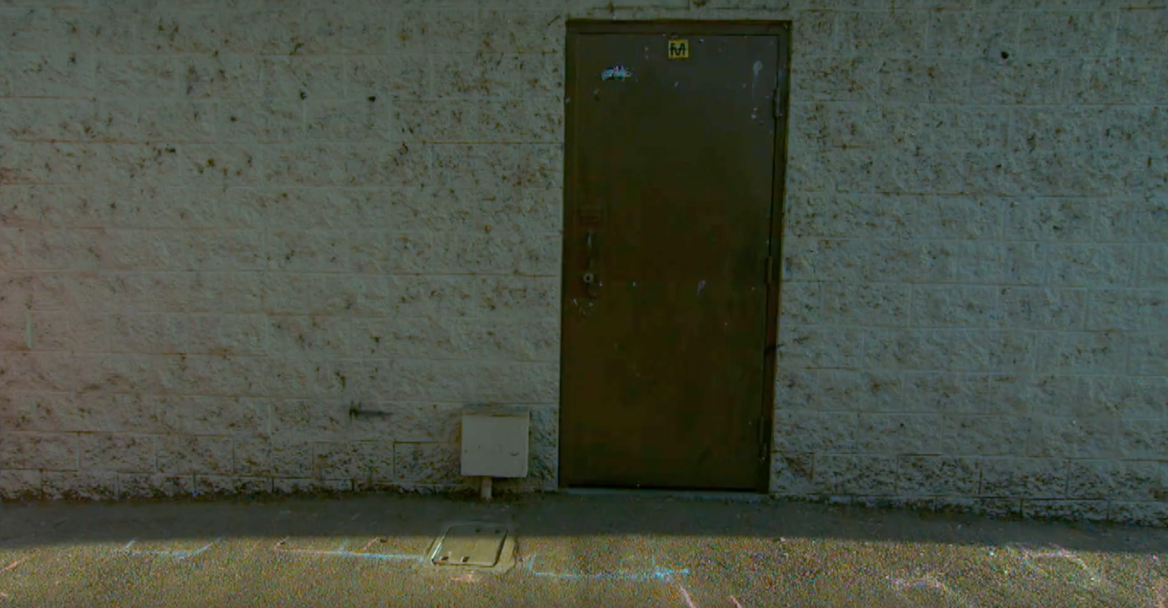
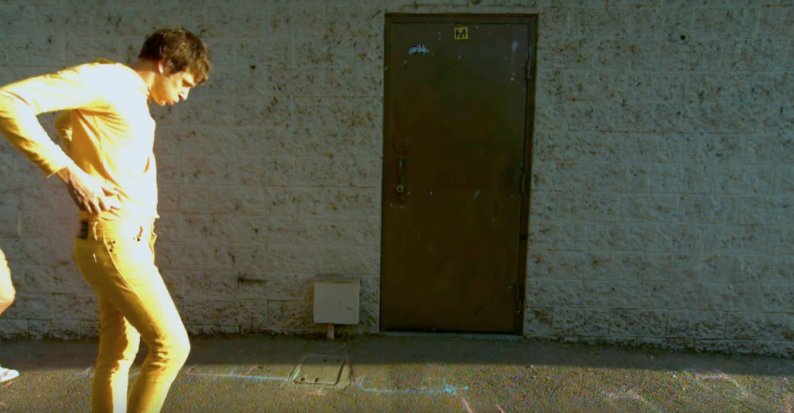
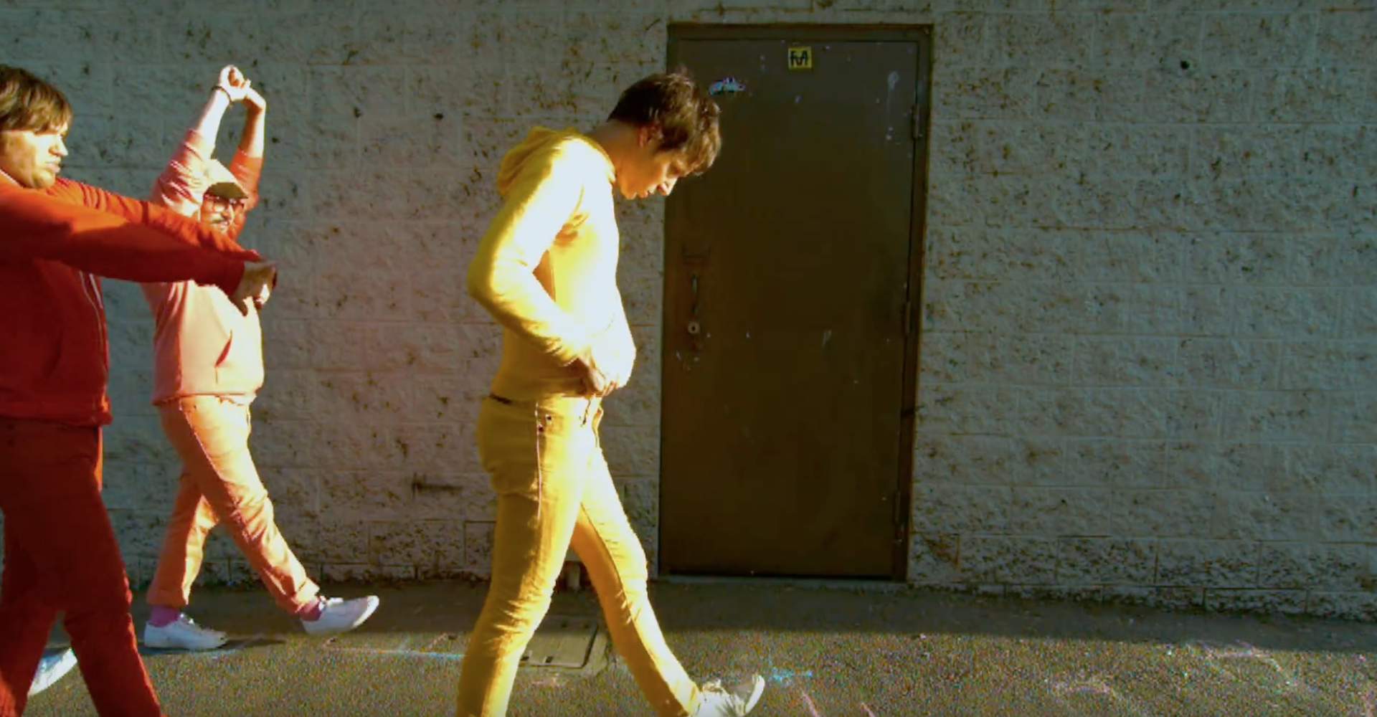
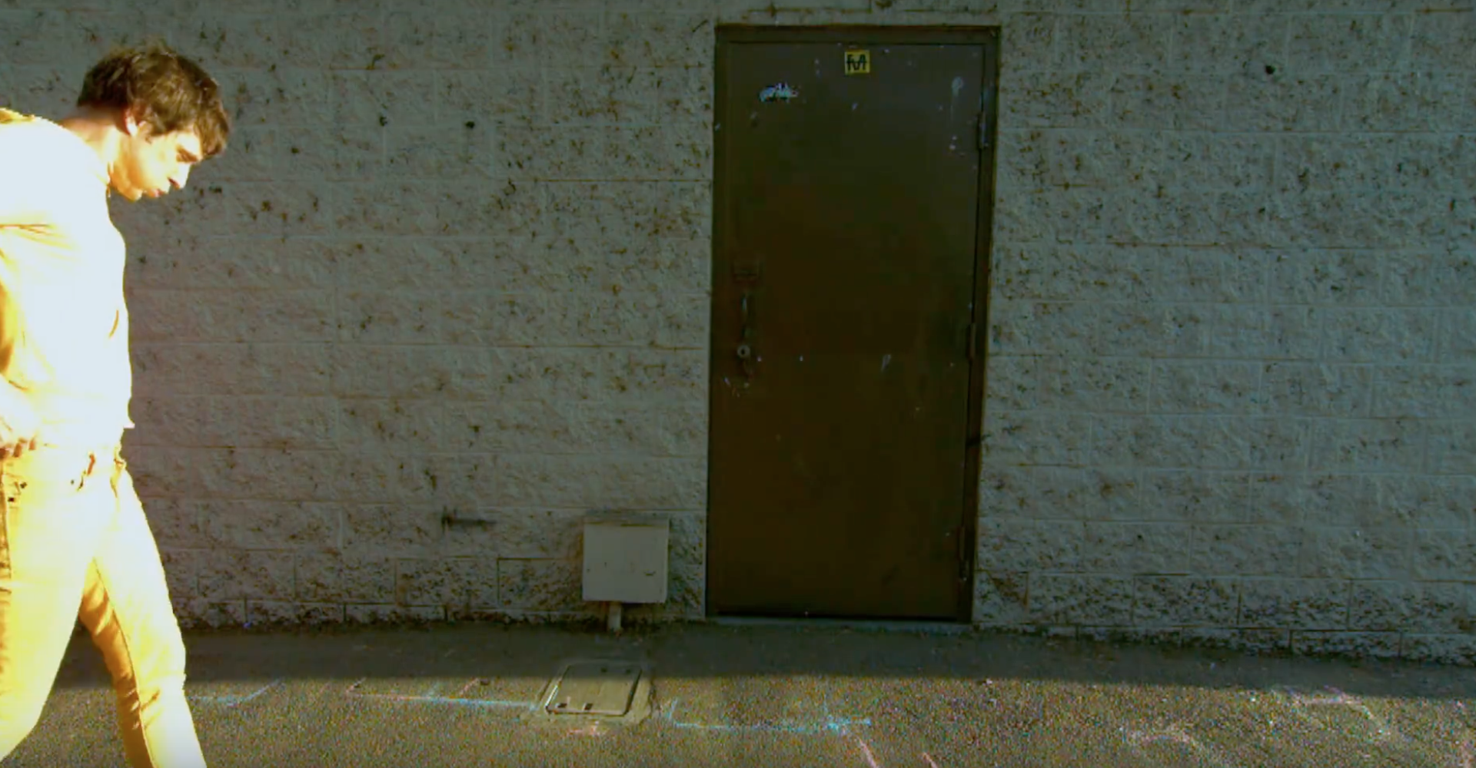
Input

Slide 3
Background

Slide 4
Focus Picture1

Slide 5
Motion Segmentation

Slide 6
SizeFilter

Slide 7
Expansion

Slide 8
Contraction

Slide 9
Focus Picture2

Slide 10
Motion Segmentation

Slide 11
SizeFilter

Slide 12
Expansion

Slide 13
Contraction

Slide 14
Focus Picture3

Slide 15
Motion Segmentation

Slide 16
SizeFilter

Slide 17
Expansion

Slide 18
Contraction

